Slide 1


Ahmed Muhammad Ahmed
2/19/2024

Slide 2

Outline
Executive Summary
Introduction
Methodology
Results
Conclusion
Future Work

Slide 3
Executive Summary
To address this challenge, we will employ a machine learning approach utilizing public information to predict SpaceX's first-stage reuse decision for their Falcon 9 launches. This will provide valuable insights for Space Y to: Estimate launch costs: Knowing the reusability probability allows Space Y to factor in potential first-stage recovery expenses and set competitive launch prices. Inform decision-making: The model's predictions can support strategic planning and resource allocation related to first-stage recovery efforts.
Developed machine learning model: A trained model capable of predicting SpaceX's first-stage reuse decisions based on publicly available data. Interactive dashboards: Visualizations presenting key insights and model performance metrics for effective communication and decision-making within Space Y. Cost estimations: Utilizing the model's predictions, Space Y can estimate launch costs considering potential first-stage reusability.

Slide 4
Introduction
The space industry is witnessing a surge in private companies offering affordable space travel solutions. This project focuses on Space Y, a new competitor aiming to rival SpaceX, led by Billionaire industrialist Allon Musk.
Space Y needs to determine the launch price for their Falcon 9 rockets, considering the crucial factor of first-stage reusability. While SpaceX advertises Falcon 9 launches at a significantly lower cost due to reusable first stages, Space Y lacks the expertise and data to predict this aspect for their own launches.

Slide 5

Section 1

Slide 6
Methodology
This project utilizes two primary methods to gather data about SpaceX Falcon 9 launches: 1. SpaceX REST API: Target URL: api.spacexdata.com/v4/launches/past Method: GET request using the requests library Response format: JSON (list of JSON objects representing individual launches) Processing: Converted to a Pandas dataframe using json_normalize for further analysis. Specific data points extracted using additional API calls for details like booster, launchpad, payload, and core. 2. Web Scraping: Package: BeautifulSoup Target: HTML tables containing Falcon 9 launch records on relevant websites. Process: Parse data from tables and convert it into a Pandas dataframe. Data Wrangling: Filtering: Data is filtered to remove launches involving the Falcon 1 booster, focusing solely on Falcon 9 launches. Handling null values: PayloadMass: Null values are replaced with the calculated mean of the column. LandingPad: Null values are left as-is, representing unused landing pads, and will be addressed later using one-hot encoding.

Slide 7
Data Collection
Data Cleaning and Wrangling: Filtering: The combined dataset underwent filtering to remove launches involving the Falcon 1 booster, ensuring the focus remained solely on Falcon 9 launches.
LandingPad: Null values in the LandingPad column were left, as they represent situations where a landing pad wasn't used. These null values will be handled later using one-hot encoding during data preparation for model training.

Slide 8
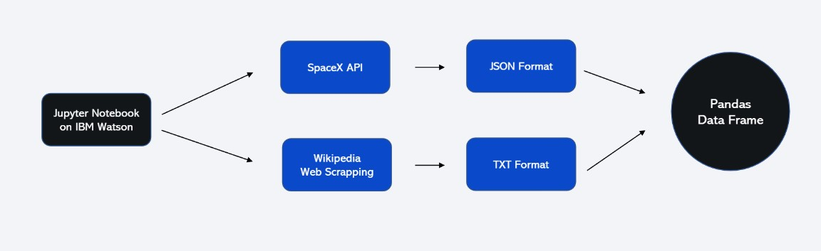
Data Collection – SpaceX API
This project utilizes two primary methods to gather data about SpaceX Falcon 9 launches: 1. SpaceX REST API: Target URL: api.spacexdata.com/v4/launches/past Method: GET request using the requests library Response format: JSON (list of JSON objects representing individual launches) Processing: Converted to a Pandas dataframe using json_normalize for further analysis. Specific data points extracted using additional API calls for details like booster, launchpad, payload, and core.
Place your flowchart of SpaceX API calls here

Slide 9
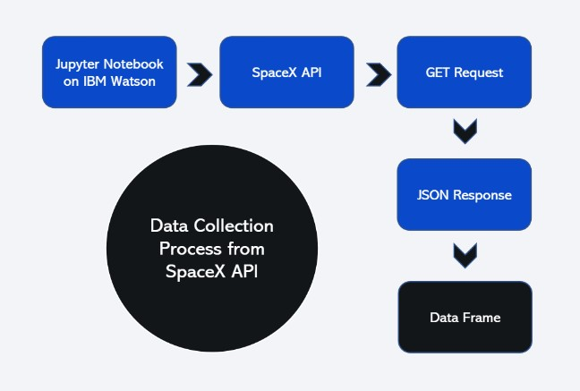
Data Collection - Scraping
Web Scraping: Package: BeautifulSoup Target: HTML tables containing Falcon 9 launch records on relevant websites. Process: Parse data from tables and convert it into a Pandas dataframe.
Place your flowchart of web scraping here

Slide 10
Data Wrangling
Filtering: Data is filtered to remove launches involving the Falcon 1 booster, focusing solely on Falcon 9 launches.
LandingPad: Null values are representing unused landing pads and will be addressed later using one-hot encoding.

Slide 11
EDA with Data Visualization
Bar charts: Compare the frequency of successful and failed landing attempts. Visualize the distribution of launch outcomes across different launch years or orbital destinations.
Line charts: Track trends in launch costs over time, potentially highlighting the impact of reusability on cost reduction. Explore potential correlations between payload weight and reusability decisions.
Scatter plots: Investigate relationships between various features like launch location, flight duration, and reusability outcomes.

Slide 12
EDA with SQL
Display the names of the unique launch sites in the space mission.
• Display 5 records where launch sites begin with the string 'CCA’.
• Display the total payload mass carried by boosters launched by NASA (CRS).
• List the date when the first successful landing outcome in ground pad was achieved.
• List the names of the boosters which have success in drone ship and have payload mass greater than 4000 but less than 6000. • List the total number of successful and failure mission outcomes.
• List the names of the booster versions which have carried the maximum payload mass.
• List the failed landing outcomes in drone ship, their booster versions, and launch site names for the in year 2015.
• Rank the count of landing outcomes (such as Failure (drone ship) or Success (ground pad)) between the date 2010-06- 04 and 2017-03-20, in descending order.

Slide 13
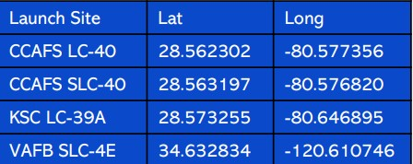
Build an Interactive Map with Folium
Building an Interactive Map with Folium
Markers were used to represent the same sites to the successful/failed first stage of rockets return using marker objects
The distances between the launch site (CCAFS LC40) to its proximities 1-the closest city, 2-coastline, and 3-highway. Then we drew polylines to represent these distances using PolyLine object

Slide 14
Predictive Analysis (Classification)
Machine Learning Stages:
1- Importing the required libraries.
2- Loading the cleaned data.
3- Standardizing the data to prevent the bias.
4- splitting the data into 20% for testing data and 80% training data.
5- Initializing 4 different classification algorithms: o Logistic Regression (LR) o Support Vector Machine (SVM) o Decision Tree (DT) o K nearest neighbors (KNN)
6- Using Grid Search technique to find the best parameters
7- Using Evaluation techniques including, Confusion matrix , F1 score, Jaccard Score for the purpose of using the best model among the algorithms above.

Slide 15
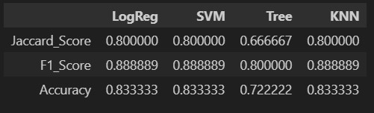
Results
Logistic Regression, Support Vector Machine (SVM), and K-Nearest Neighbors (KNN) exhibit comparable performance. However, I will consider Logistic Regression as the optimal model due to its simplicity and interpretability. It is generally more straightforward than SVM, while KNN may experience slower performance with larger datasets due to the need for distance calculations for all training samples.

Slide 16

Section 2

Slide 17
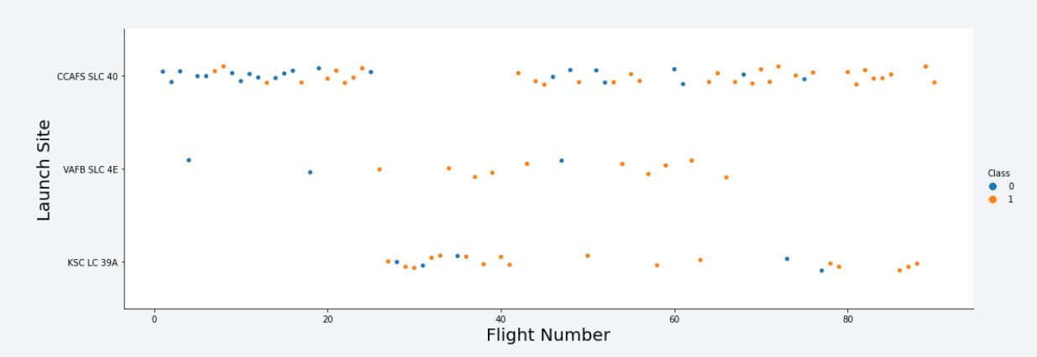
Flight Number vs. Launch Site
1- CCAFS SLC 40 : is the most usable site for launching SpaceX's rockets and it has 55 trials, 33 of them are successful and 22 of them are failed # 60% success rate 2- VAFB SLC 4E : is the least usable site for launching SpaceX's rockets and it has 13 trials, 10 of them are successful and 03 of them are failed # 77% success rate 3- VAFB SLC 4E : is a moderate site in terms of launching SpaceX's rockets and it has 22 trials, 17 of them are successful and 05 of them are failed # 77% success rate

Slide 18
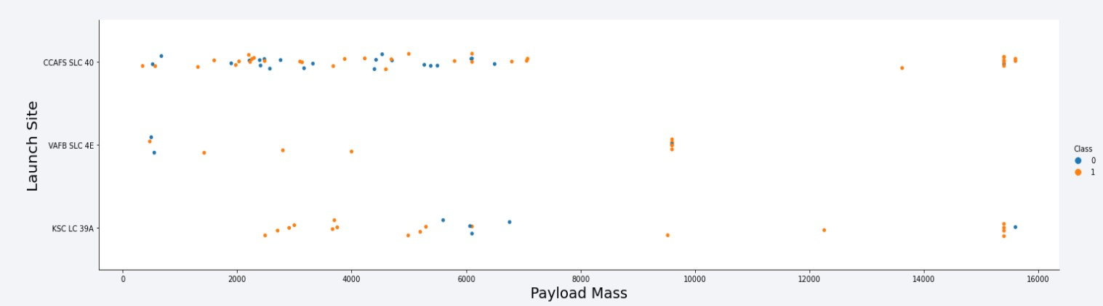
Payload vs. Launch Site
We can not say that there is a correlation between the two variabls

Slide 19
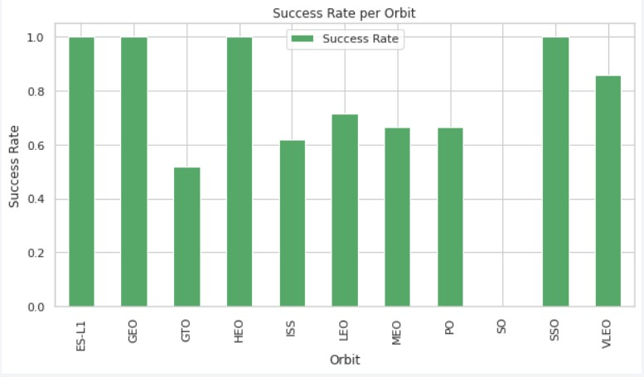
Success Rate vs. Orbit Type
The figure shows the best and the worst orbits

Slide 20
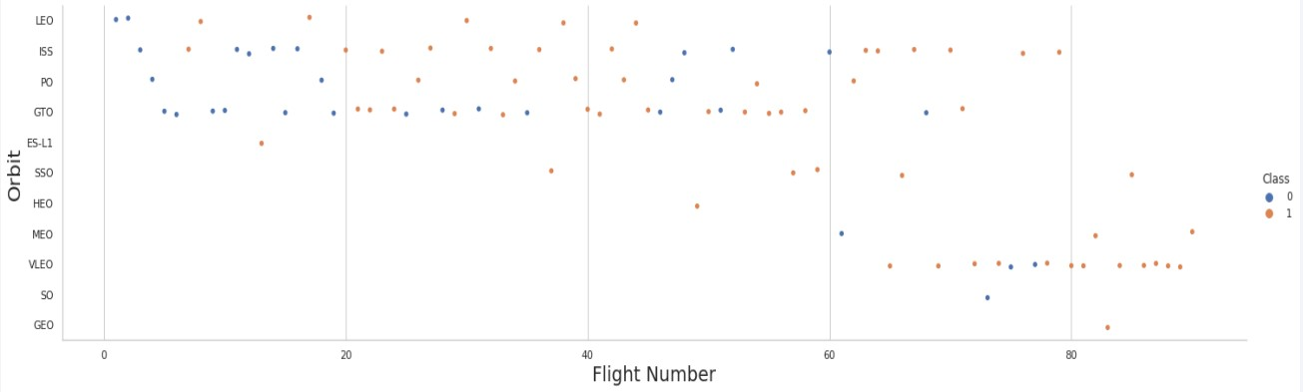
Flight Number vs. Orbit Type
There is a correlation between the leo orbit and number of flights

Slide 21
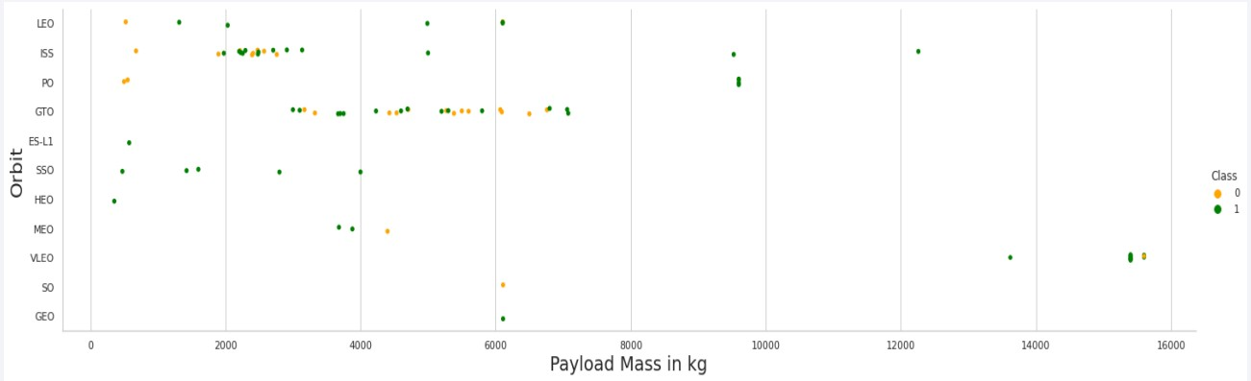
Payload vs. Orbit Type
There is a negative correlation between payloads and GTO orbits

Slide 22
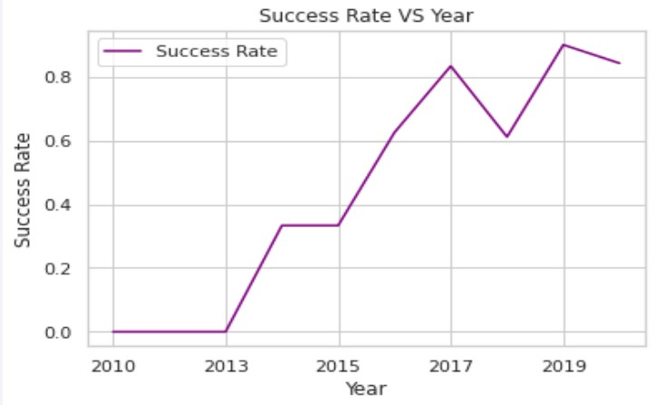
Launch Success Yearly Trend
The success rate since 2013 kept increasing till 2017 (stable in 2014) and after 2015 it started increasing.

Slide 23
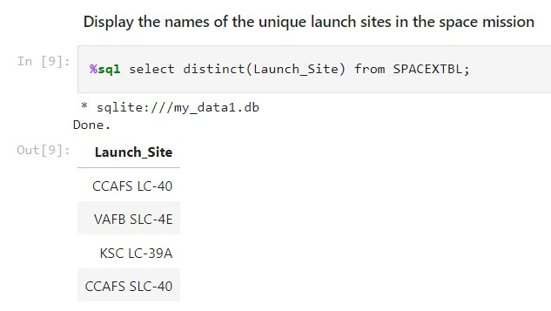
All Launch Site Names

Slide 24
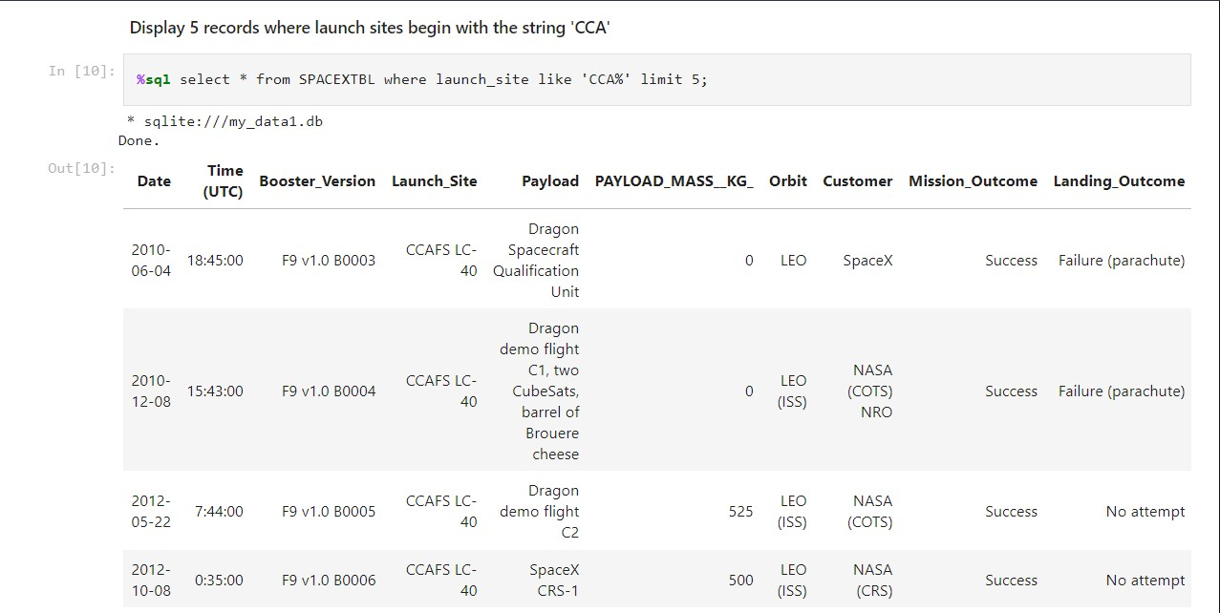
Launch Site Names Begin with 'CCA'

Slide 25
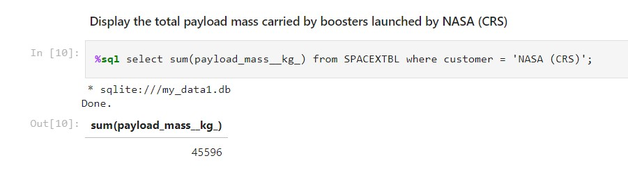
Total Payload Mass

Slide 26
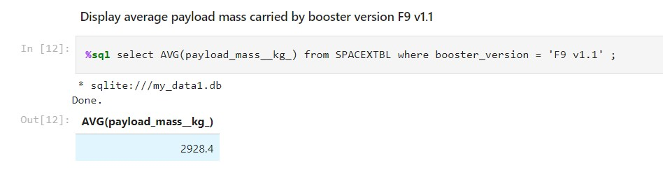
Average Payload Mass by F9 v1.1

Slide 27
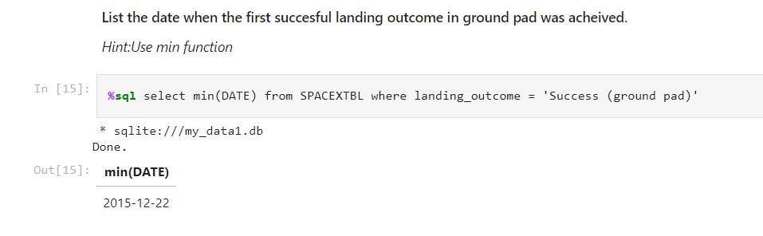
First Successful Ground Landing Date

Slide 28
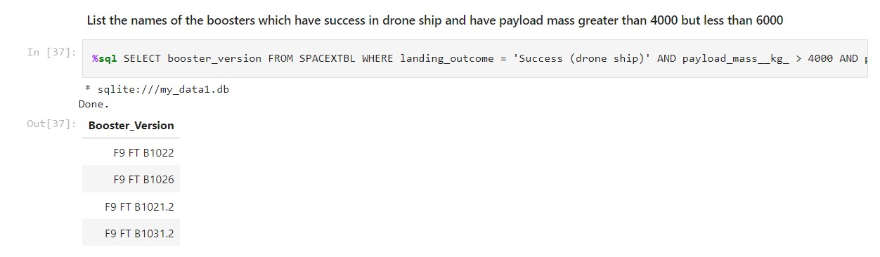
Successful Drone Ship Landing with Payload between 4000 and 6000

Slide 29
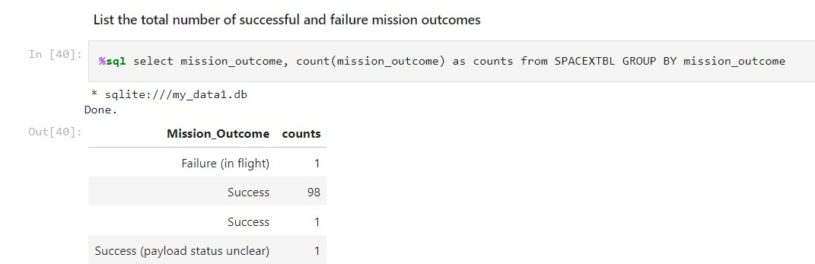
Total Number of Successful and Failure Mission Outcomes

Slide 30
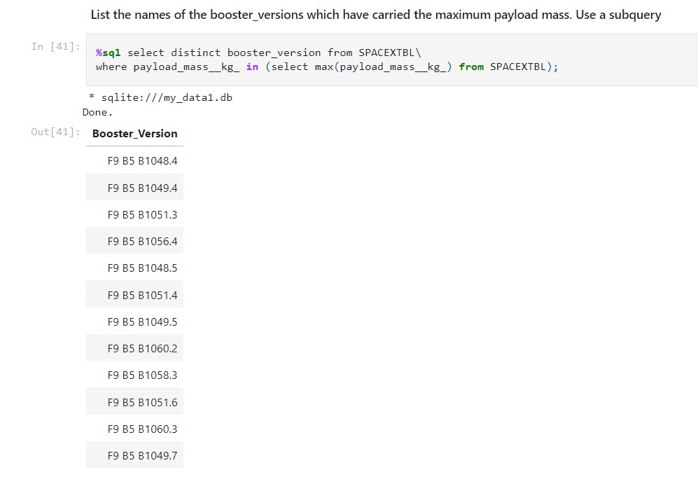
Boosters Carried Maximum Payload

Slide 31
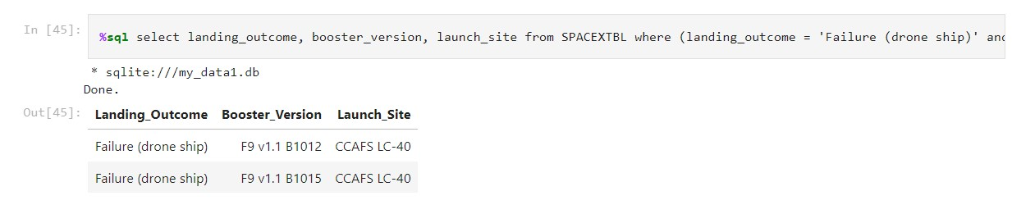
2015 Launch Records

Slide 32
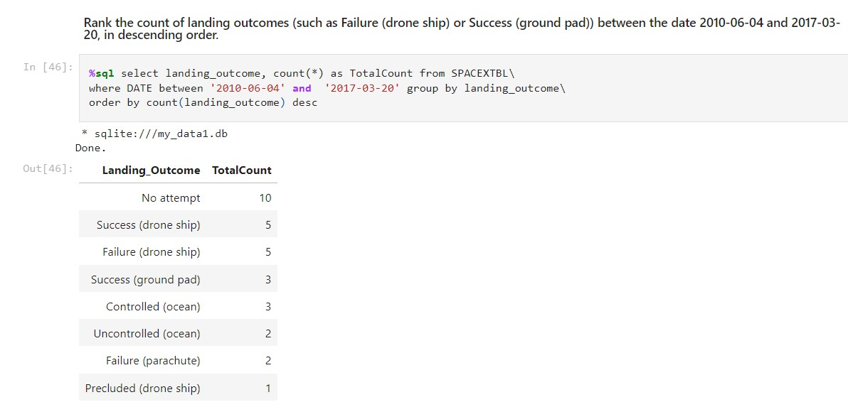
Rank Landing Outcomes Between 2010-06-04 and 2017-03-20

Slide 33

Section 3

Slide 34
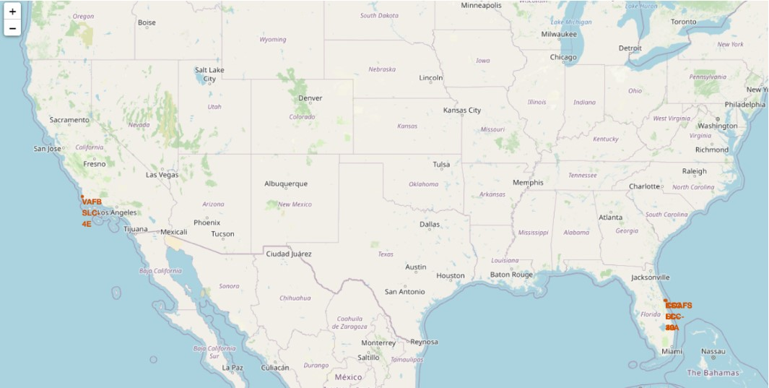
<Folium Map Screenshot 1>
All launch sites in proximity to the Equator line, All of the launch sites are very close to the coast to avoid accidents, and very close to florida.

Slide 35
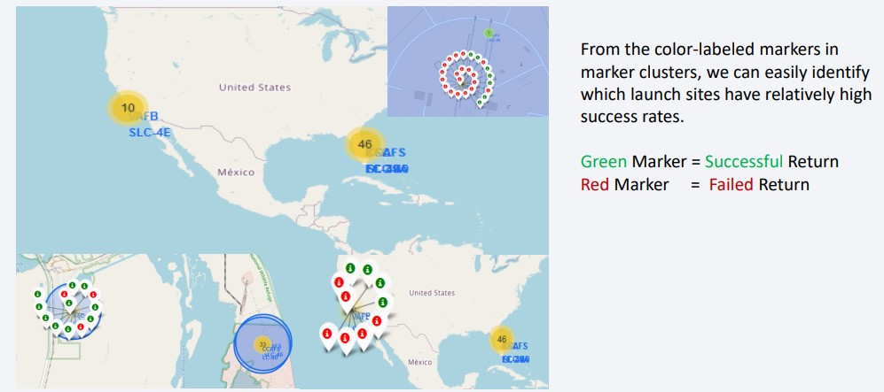
<Folium Map Screenshot 2>

Slide 36
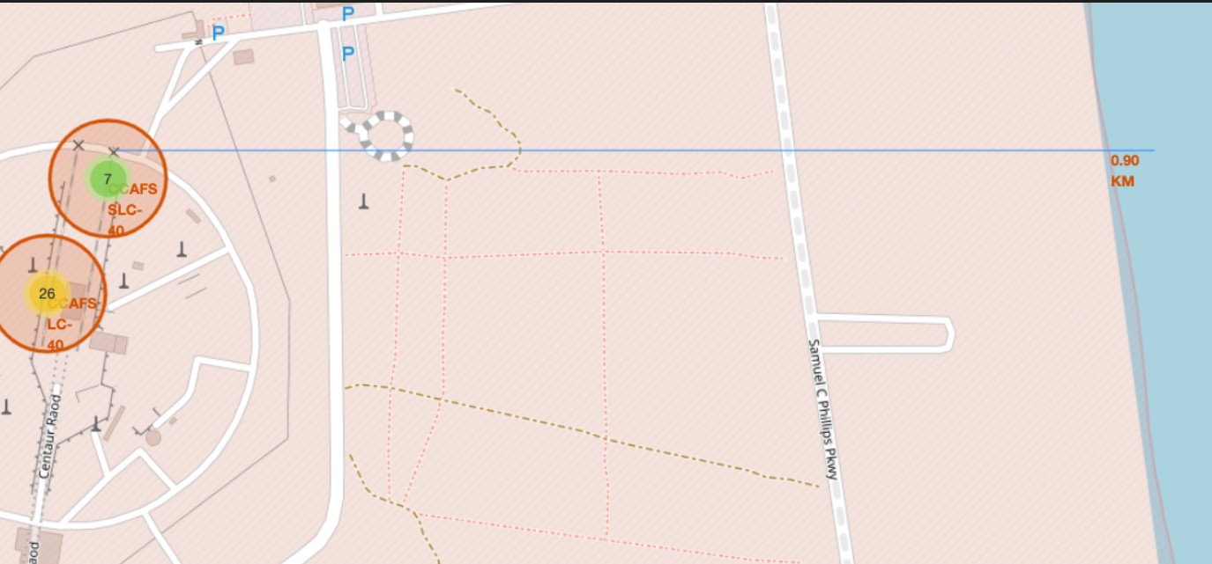
<Folium Map Screenshot 3>

Slide 37
The analysis shows the following:
The launch site KSC LC-39A is strategically located in close proximity to transportation infrastructure, with a railway (15.23 km) and highway (20.28 km) nearby. Additionally, its proximity to the coastline (14.99 km) and the city of Titusville (16.32 km) raises concerns about potential risks in case of a failed rocket launch. The high speeds of failed rockets could pose a danger to populated areas within a 15-20 km radius.

Slide 38

Section 5

Slide 39
Classification Accuracy
Logistic Regression, Support Vector Machine (SVM), and K-Nearest Neighbors (KNN) exhibit comparable performance. However, I will consider Logistic Regression as the optimal model due to its simplicity and interpretability. It is generally more straightforward than SVM, while KNN may experience slower performance with larger datasets due to the need for distance calculations for all training samples.

Slide 40
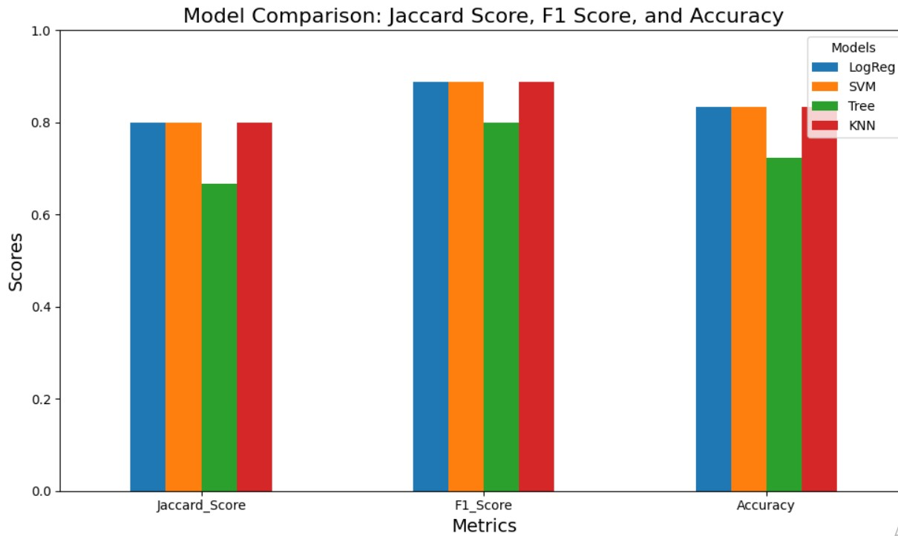
Comparison between models

Slide 41
Conclusion
Data Acquisition and Preparation:
- Successfully scraped launch data for Falcon 9 and Falcon Heavy rockets from Wikipedia.
Exploratory Data Analysis (EDA):
- Conducted a thorough EDA to identify key factors influencing landing success and establish clear training labels.
Geographical Insights:
- Utilized Folium to visualize launch site locations and their geographical context.
Machine Learning Model Development:
- Built and evaluated multiple machine learning models, including Logistic Regression, SVM, KNN, and Decision Trees.
Model Deployment:
- Deployed the best-performing model using a Streamlit application for user interaction and predictions.

Slide 42
Future Work
Additional Features: Incorporate environmental conditions and real-time telemetry data.
Advanced Modeling: Explore ensemble methods or deep learning techniques.
Expanded Dataset: Gather more launch data for a more robust analysis

Slide 43


